Slide 1

Talking Fabric: Analytics in SMC
Jason Eisenzimmer
Technical Specialist

Slide 2
What are we doing today?
Brief Technical discussion
Strategies for expansion
Icebreaker demo
Q&A (if time allows)
Landing guidance

Slide 3
Key Takeaways
Fabric is an expansion, not a migration
Dark to DW customers- understand needs
We sell solutions, not products
Free Trials are a powerful tool
Demos help open the door

Slide 4

Who is Jason
Started in 2016 (SQL BI Support)
Support TA: 2017-2019
SMC TS > SMC CSA > SMB CSM > SMC CSA > SMC TS
Analytics Ace

Slide 5

A Brief Technical Briefing

Slide 6
Why leverage Lakehouse?
Merger of Parquet with transaction logs
RDBMS features on flat files
Schema enforcement
ACID transactions
Time Travel
Statistics in logs
Data Skipping
Less duplication of effort
Decrease development speeds
Unlimited Scale
Spark is extremely powerful from a transformation perspective
Native Connectivity

Slide 7
Medallion Architecture – multiple data layers
 | Raw | Bronze | Silver | Gold
Who uses it? | Automated Processes | Data engineers | BI/Data Scientists | End consumers
What? | 1:1 copy of the data from the source system | Uncleaned raw data saved in delta format | Fix Bronze Schemas, remove errors, explode columns | Aggregated/ mashed up fact and dimension data
Why? | System of record | Exploration of raw data | Feature engineering | Analytics consumption

Slide 8
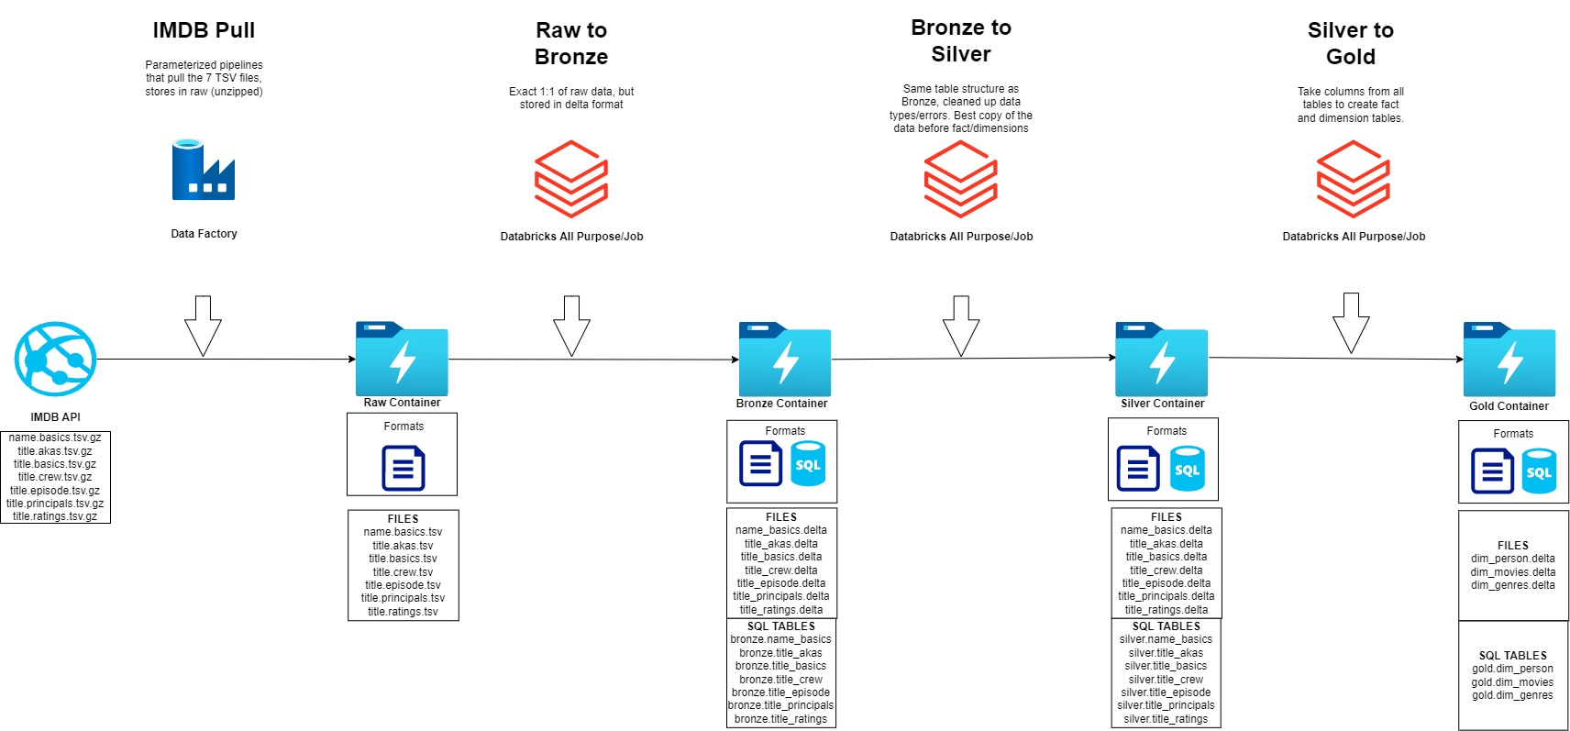
Data Flow: Step by Step
Transform
Serve
Notes:
I am a lazy man, so I left this slide as is from my old Delta lake conversations, as evident by the Databricks logos. The theory is still the same and we will come back to that later

Slide 9

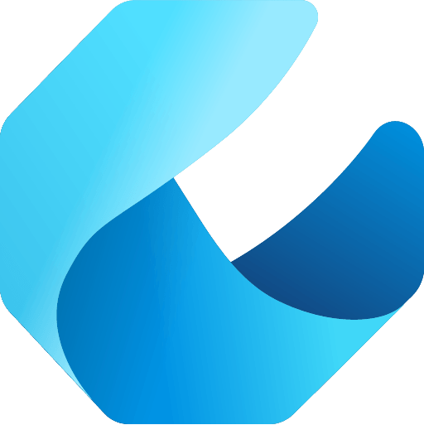

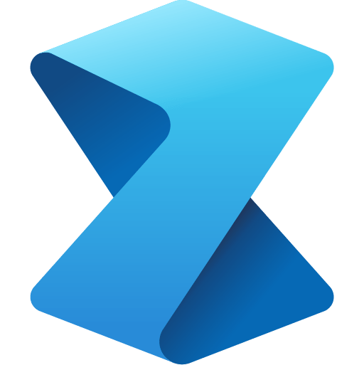

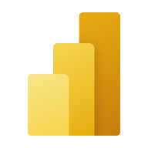
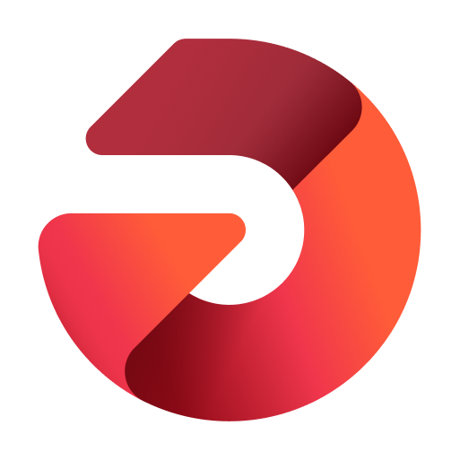

Microsoft Fabric does it all—in a unified solution
An end-to-end analytics platform that brings together all the data and analytics tools that organizations need to go from the data lake to the business user
Data Integration
Data Engineering
Data Warehouse
Data Science
Real Time Analytics
Business Intelligence
Observability
Data Factory
Synapse
Synapse
Synapse
Synapse
Power BI
Data Activator
Unified data foundation
OneLake
UNIFIED
SaaS product experience
Security and governance
Compute and storage
Business model
Notes:
Microsoft Fabric combines Data Factory, Synapse Analytics, Data Explorer, and Power BI into a single, unified experience, on the cloud. The open and governed data lakehouse foundation is a cost-effective and performance-optimized fabric for business intelligence, machine kerning, and AI workloads at any scale. It is the foundation for migrating and modernizing existing analytics solutions, whether this be data appliances or traditional data warehouses.
Talk Track for Greenfield/Growing Analytics Customers – Microsoft Fabric’s SaaS environment makes it easier to deploy an entire end-to-end analytics engine from the ground up at an accelerated pace. With the solution’s built-in security and governance capabilities, you can be rest assured your data and insights are protected.
Talk Track for Existing Synapse Customers – Microsoft Fabric is an evolution of Azure Synapse. You will still be able to enjoy the benefits and limitless scale of Synapse in an easier to use SaaS solution while adopting new capabilities that enhance your entire analytics approach. And with the addition of Power BI, you can help democratize the ability to uncover insights and create interactive reports across the organization, helping everyone make more data-driven decisions in their everyday work.
Talk Track for Existing Power BI Customers – With Microsoft Fabric, you’ll be able to access new and powerful data tools and services like Azure Synapse within the same user experience you already enjoy with Power BI. You can unify these tools with your disparate data sources in the same environment to establish a single source of truth for all data, driving the ability for everyone to uncover more accurate and consistent insights than before. And instead of having to worry about security concerns of a patchwork analytics estate, you can be rest assured your data is protected with the built-in security and governance capabilities.

Slide 10
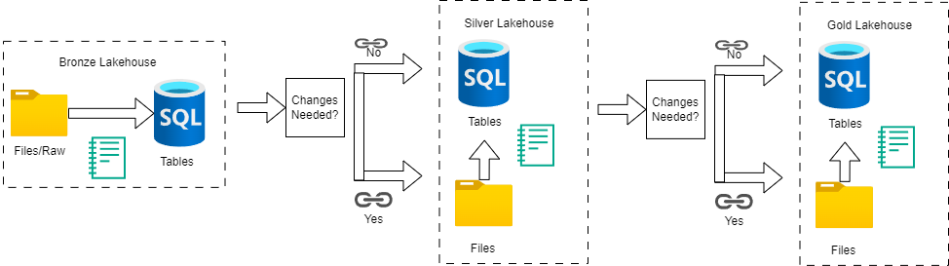
Medallion in Fabric

Slide 11
Landing Fabric

Slide 12
How to land Fabric
Move away from a product
Determine what they want/what they need
If Fabric is a fit, move forward with demo
Position Free trial
Workshop

Slide 13
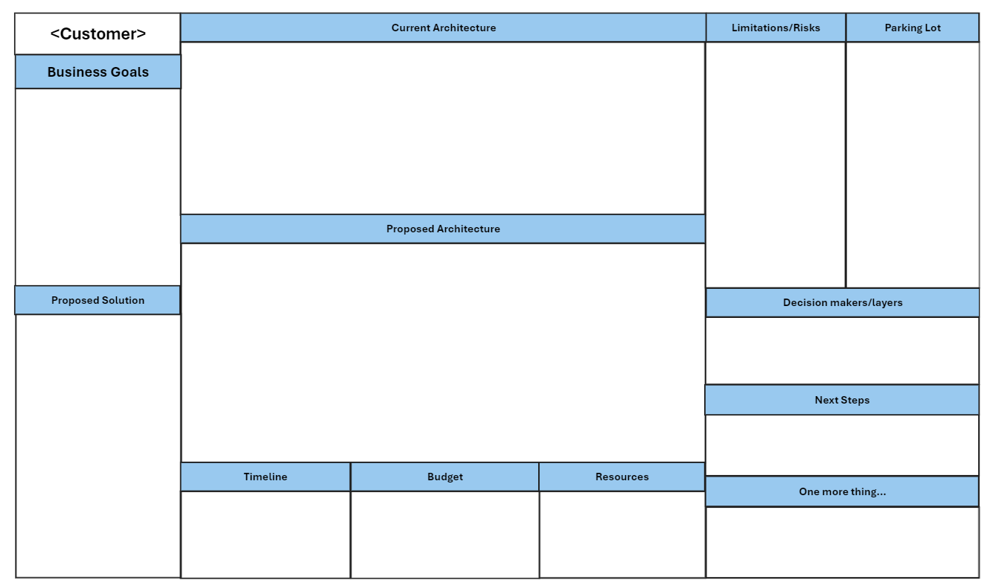
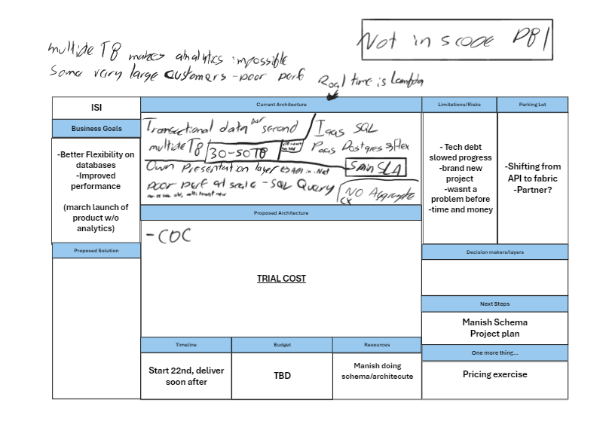
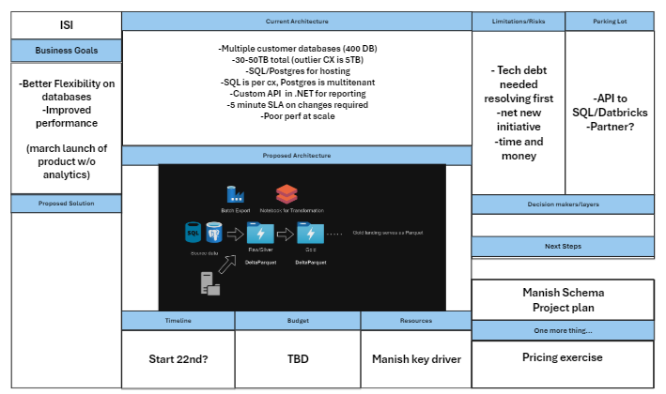
Mini-MTC
Book 2 hour session with customer shareholders
Fill in box by box
Focus on high level, not super deep technical discussions
After completion of session 1, refine
Present refined version 1 week later and let customer evaluate
Deliver document and plan next steps

Slide 14
Thoughts on pilots
Aim for 2 hour long workshops
As many as needed
Schedule a weekly “rock” call
Not a working session
Touchbase on where the last week
Plan for the next week
Customer should do the bulk of the heavy lifting
SCOPE! SCOPE! SCOPE!
SET EXPECTATIONS!
Make sure everyone knows the exact plan by the end of planning
dentify a very small vertical slice of source data/workload

Slide 15
Fabric as an Expansion

Slide 16
Oops! All Databricks
Current state: Customer is using Databricks for ETL, Prep and serve via Warehouse
Options:
Fabric supports the full use cases of Databricks, so they can do some or all components in Fabric
Notebooks: can stay in Databricks and write to one lake or ADLS. Migrating is super simple
Storage: We can shortcut to the existing ADLS or write straight to OneLake
Compute: Databricks can read OneLake, or could migrate to Fabric Lakehouses
Long term we will have tighter integration with Unity Catalog and Purview
This is the easiest solution to augment hands down!

Slide 17


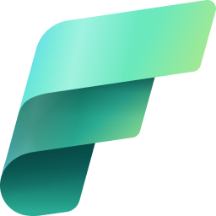

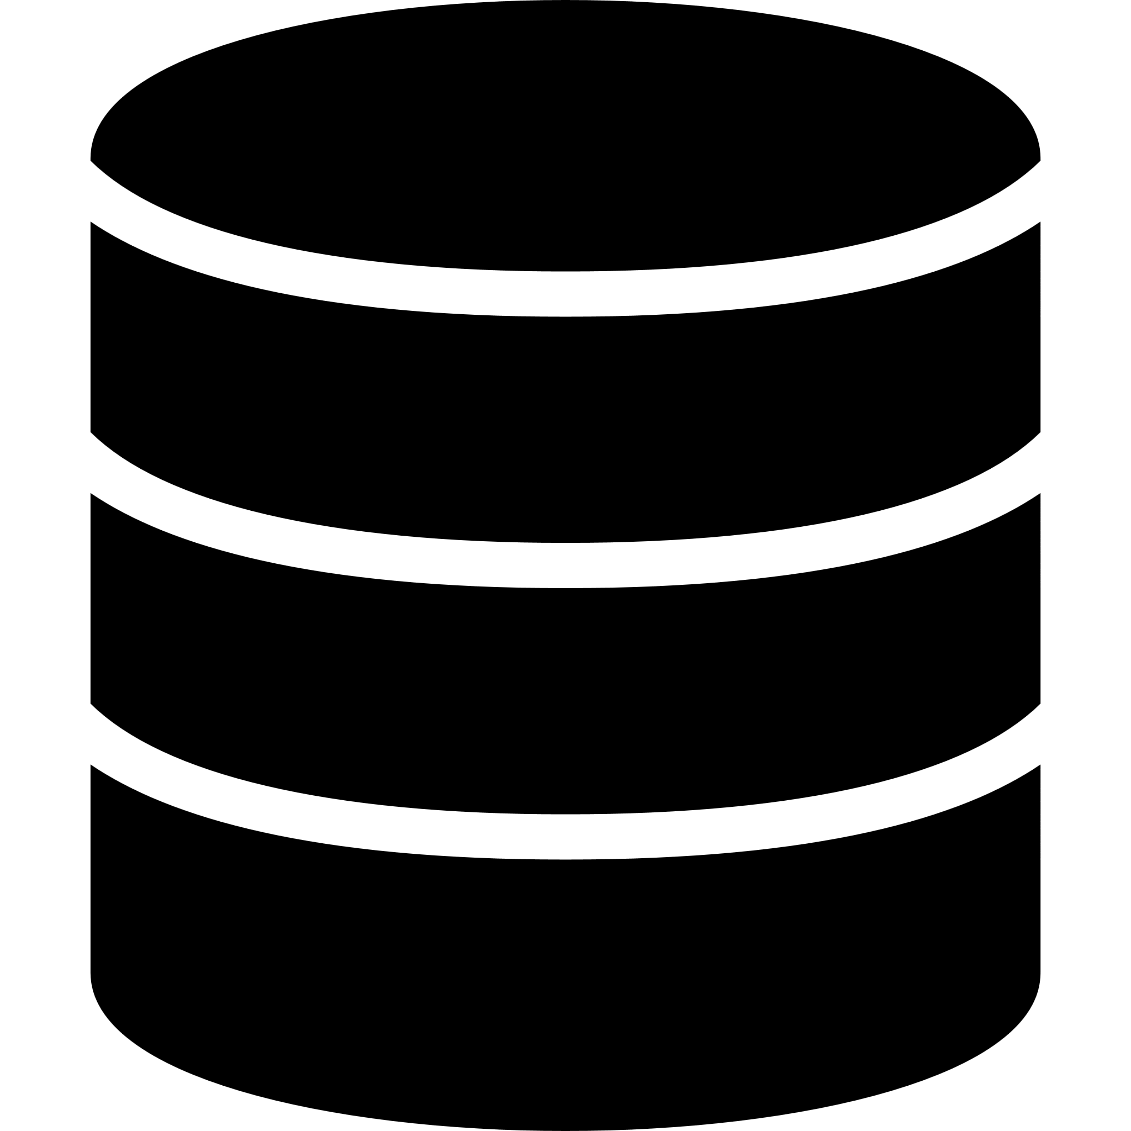
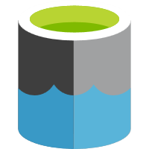

Integration Databricks and Microsoft Fabric – Store Delta tables in an ADLS (shortcuts) https://learn.microsoft.com/en-us/fabric/onelake/create-adls-shortcut
Metadata exchange
Governance using Microsoft Purview
Process
Process
Data landing zone (PaaS)
Microsoft Fabric
(SaaS)
Ingest Copy data using Data Factory
Azure Databricks
Azure Databricks
Operational systems
Reporting
Lakehouse Bronze Typically, raw and different file formats
Lakehouse Silver Typically, cleansed and standardized file formats
Lakehouse Gold Ready for consumption
Serve Provide shortcuts
Data science
Blob landing zone
Orchestrate using Azure Data Factory

Slide 18
Integration Databricks and Microsoft Fabric – Gold layer only in OneLake https://learn.microsoft.com/en-us/fabric/onelake/create-adls-shortcut
Metadata exchange
Governance using Microsoft Purview
Process
Process
Data landing zone (PaaS)
Microsoft Fabric
(SaaS)
Ingest Copy data using Data Factory
Azure Databricks
Azure Databricks
OneLake
Operational systems
Reporting
Tables
ADLS Bronze Typically, raw and different file formats
ADLS Silver Typically, cleansed and standardized file formats
Lakehouse Gold Ready for consumption
Serve Provide shortcuts
Data science
Blob landing zone
Orchestrate using Azure Data Factory

Slide 19
Integration Databricks and Microsoft Fabric – Store Delta tables in OneLake https://learn.microsoft.com/en-us/fabric/onelake/onelake-azure-databricks
Metadata exchange
Governance using Microsoft Purview
Process
Process
Data landing zone (PaaS)
Microsoft Fabric
(SaaS)
Ingest Copy data using Data Factory
Azure Databricks
Azure Databricks
OneLake
Operational systems
Reporting
Tables
Tables
Tables
Lakehouse Bronze Typically, raw and different file formats
Lakehouse Silver Typically, cleansed and standardized file formats
Lakehouse / Warehouse Gold Ready for consumption
Serve Provide shortcuts
Data science
Blob landing zone
Orchestrate using Azure Data Factory

Slide 20
Databricks + Synapse
Current state: Databricks is the ETL/Transform, and they serve with Dedicated Pools
(GA) Options:
Databricks notebooks/storage could move (see previous)
Synapse Pools cannot move natively
Code migration tool is coming FY25Q1
Work with SI to move, or treat it as net new Lakehouse implementation
Long term: Automated code migration tool coming, replication via mounting coming

Slide 21
Oops! All Synapse
Current State: ETL, Notebooks, Serve, Storage all in Synapse Workspaces
(GA) Options:
Leave as is
Otherwise treat as net new DW
Work with SI to migrate
Azure Migration Accelerator is a good option as well
Long term: Automated code migration tool coming, replication via mounting coming

Slide 22
Pros and Cons

Slide 23
Common blockers and Tactics
Granular Security
One Security model is coming
OLS exists in warehouses/SQL endpoint + RLS in PBI Models
Network security
VNET integration for notebooks coming
VNET integration for Dataflows just went public
ADF+SHIR still powerful option
Sizing
Free trial
Capacity metric app

Slide 24
Why fabric is great
Direct Lake Mode
5x5
SaaS
One Compute
OneLake
Frictionless onboarding
Predictable Cost
Minimal knobs
Any Data
New query mode
Instant provisioning
One Tenant Governance
Auto optimized
Anywhere
Fast Update
Quick results w/ Intuitive UX
Centralized Security
Auto integrated
No Movement
Top Performance
Notes:
5x5: Frictionless onboarding and instant provisioning.
SaaS: Predictable cost instead of variable consumption cost.
One Compute: Do more with less! Same compute resources are used for governance, warehousing, integration, data science, reporting, and analytics. No individual provisioning required, giving you optimized performance where it’s needed with the simplicity and savings of single compute.
One Data Lake: The world's first multi-cloud data lake (OneLake) for any data type, anywhere, without data movement.
Direct Lake Mode: Both the fast data updates of Direct Query combined with the performance of Import Mode all the time.

Slide 25

Demo DW in 20 minutes

Slide 26

Q&A

Slide 27
Key Takeaways
Fabric is an expansion, not a migration
Dark to DW customers- understand needs
We sell solutions, not products
Free Trials are a powerful tool
Demos help open the door

